Slide 1


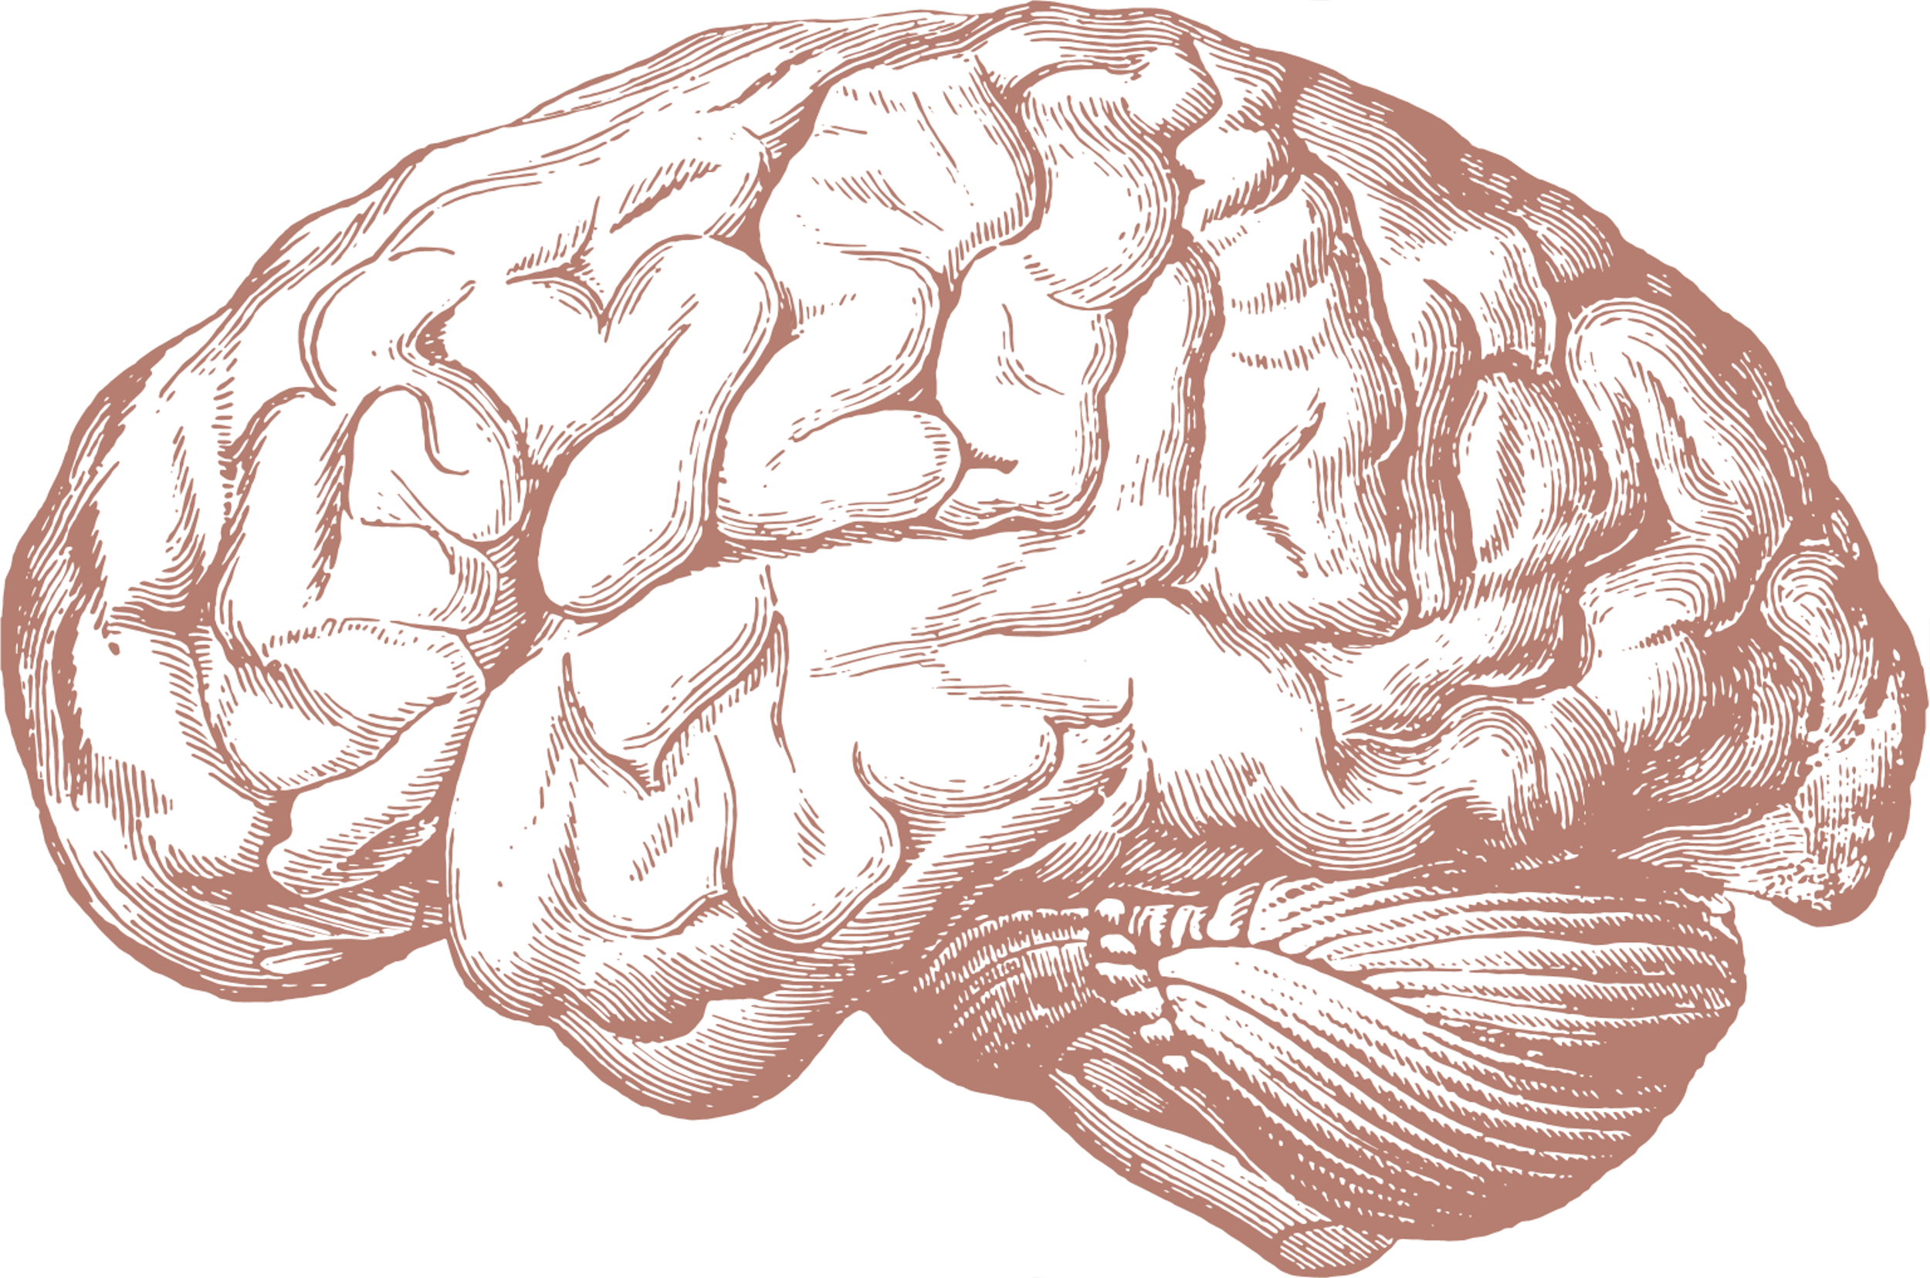

Objectives
EBI Bioinformatic tools 2024
Identify and analyze genetic variations and modifiers that influence the progression of juvenile Huntington's disease.
Specific objectives:
Molecular and genetic insights into juvenile Huntington’s disease: A review of variations and modifying factors
Yeimy Alejandra Montenegro Bacca
Catalina Rivera-Forero
Victor Hugo Rúa López
Arnold Stevens Gelves Romero

Slide 2

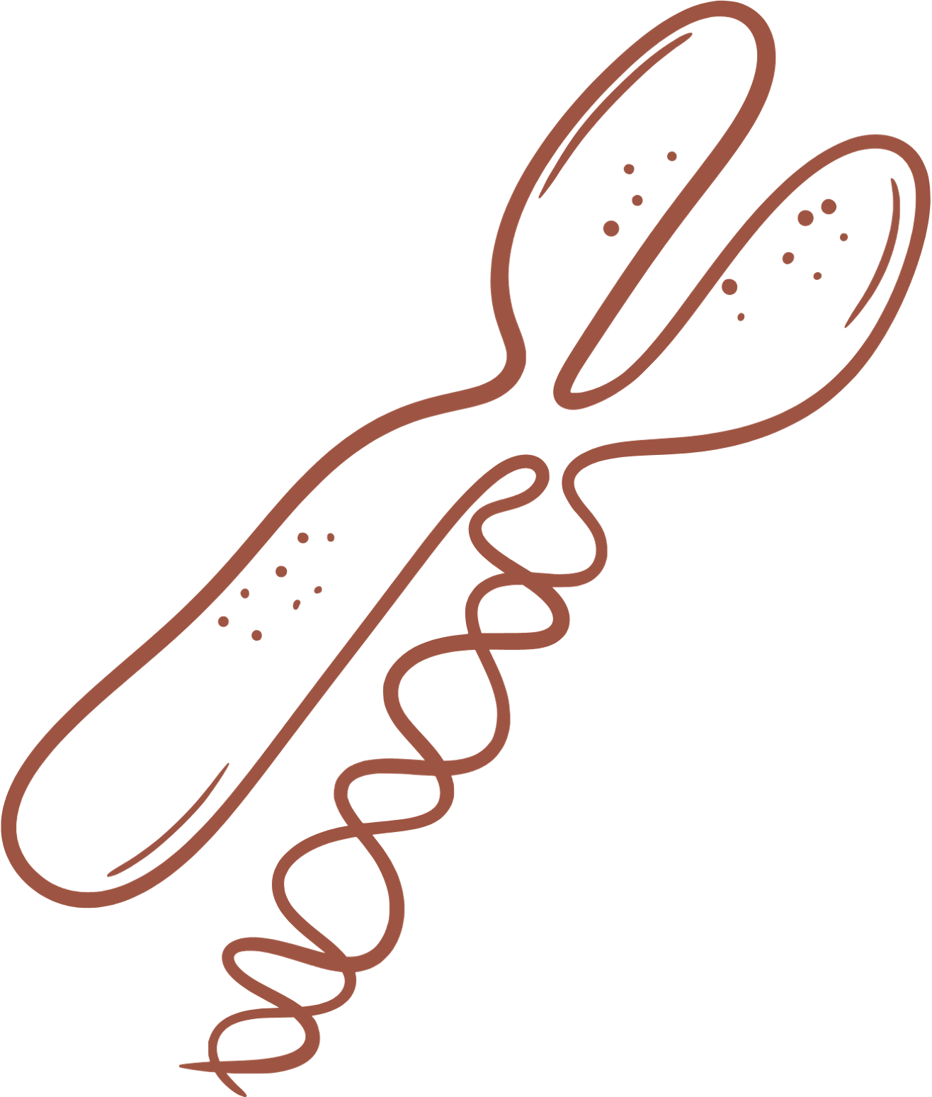



Background
Objectives
Identify and analyze genetic variations and modifiers that influence the progression of juvenile Huntington's disease.
Huntington's disease is a neurodegenerative disorder.
Progressive degradation of neurons
Specific objectives:
Basal ganglia of the brain are most affected.
Analyze variations in genes related to CAG repeat instability and their impact on disease progression.
Identify genetic factors that modify the toxicity of the mutant huntingtin protein.
Propose potential therapies based on the molecular and genetic findings.
(Bates et al., 2015; Du et al., 2021).

Slide 3



Background
Objectives
Huntington's disease is a neurodegenerative disorder.
Identify and analyze genetic variations and modifiers that influence the progression of juvenile Huntington's disease.
Expansion of CAG trinucleotide repeats (encoding glutamine) in exon 1 of the HTT gene on chromosome 4
Progressive degradation of neurons
Basal ganglia of the brain are most affected.
Specific objectives:
Analyze variations in genes related to CAG repeat instability and their impact on disease progression.
The symptomatology of the disease include:
Cognitive symptoms: memory impairment, difficulties in decision-making, and concentration problems.
Behavioral/psychiatric symptoms: personality changes, depression, and anxiety.
Identify genetic factors that modify the toxicity of the mutant huntingtin protein.
Motor symptoms: involuntary movements, stiffness, and coordination problems.
Propose potential therapies based on the molecular and genetic findings.
The mutant form of the huntingtin protein disrupts neuronal function and survival
(Bates et al., 2015; Du et al., 2021).
(Bates et al., 2015; Du et al., 2021; Young, 2003)

Slide 4


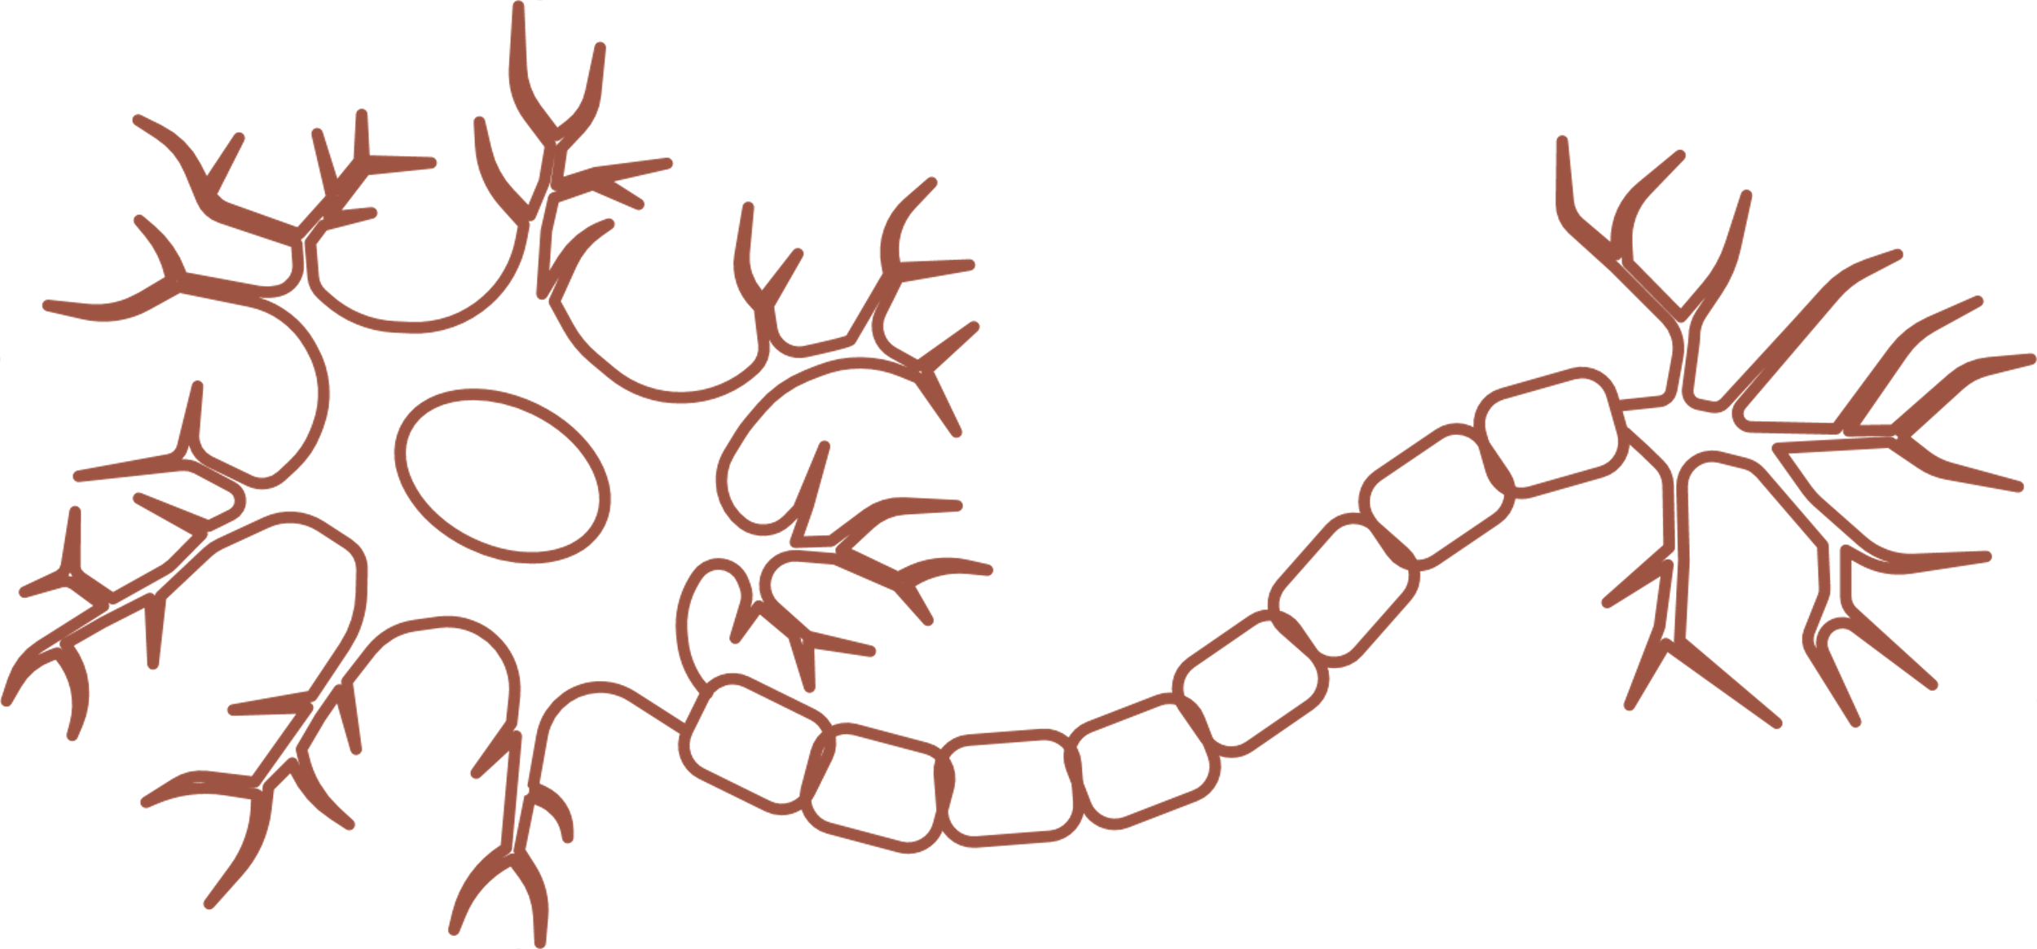

Background
Expansion of CAG trinucleotide repeats (encoding glutamine) in exon 1 of the HTT gene on chromosome 4
Autosomal dominant monogenic inherited disorder
1
2
3
4
5
6
7
8
9
10
11
12
13
14
15
16
17
18
19
20
21
22
The mutant form of the huntingtin protein disrupts neuronal function and survival
(Bates et al., 2015; Du et al., 2021; Young, 2003)
Between 36-39 CAG repeats is associated with symptom onset between the ages of 35 and 45.
Wild type
Huntington disease
Striatal neuron degeneration
Repeat expansion over time

Slide 5

Background
Between 36-39 CAG repeats is associated with symptom onset between the ages of 35 and 45.
Expansion of CAG trinucleotide repeats (encoding glutamine) in exon 1 of the HTT gene on chromosome 4
Wild type
Huntington disease
Striatal neuron degeneration
Repeat expansion over time
Juvenile-onset Huntington's disease is linked to a higher number of CAG repeats.
The patients show symptoms before the age of 20 typically having around 55 repeats.
1
2
3
4
5
6
7
8
9
10
11
12
13
14
15
16
17
18
19
20
21
22
(Young, 2003; Goold et al., 2021).
(Langbehn et al., 2010; Young, 2003; Ha et al., 2012; Andrich et al., 2008; Rubinsztein et al., 1996).

Slide 6



Background
Between 36-39 CAG repeats is associated with symptom onset between the ages of 35 and 45.
Normal Huntingtin gene
Normal Huntingtin protein
Wild type
Juvenile-onset Huntington's disease progresses more rapidly.
Huntington disease
Affect patients early in life.
Mutant Huntingtin gene
Mutant Huntingtin protein
Exacerbates motor, cognitive, and behavioral symptoms.
Striatal neuron degeneration
Repeat expansion over time
Impacts the quality of life and limits opportunities for effective therapeutic intervention.
(Young, 2003; Goold et al., 2021).
Juvenile-onset Huntington's disease is linked to a higher number of CAG repeats.
The patients show symptoms before the age of 20 typically having around 55 repeats.
(Langbehn et al., 2010; Young, 2003; Ha et al., 2012; Andrich et al., 2008; Rubinsztein et al., 1996).

Slide 7




















Background
Normal Huntingtin gene
Normal Huntingtin protein
In this context, a bioinformatics approach plays a critical role.
Juvenile-onset Huntington's disease progresses more rapidly.
Represents an interdisciplinary method that integrates data from various sources.
Affect patients early in life.
Genetic profiles
Structural profiles
Functional profiles
Exacerbates motor, cognitive, and behavioral symptoms.
Mutant Huntingtin gene
Mutant Huntingtin protein
Impacts the quality of life and limits opportunities for effective therapeutic intervention.
EBI resources were instrumental in obtaining, analyzing, and understanding the genetic information related to this disease.
The goal of the study was to identify genetic variations that influence the progression of juvenile HD.
The experimental approach prioritized specific genetic variants that influence DNA repair and age of early onset, providing key information for potential therapeutic interventions.
(Young, 2003; Goold et al., 2021).

Slide 8
HTT gene
The HTT gene provides instructions for making the huntingtin protein.
In this context, a bioinformatics approach plays a critical role.
The function of the huntingtin protein is still unclear. However, it is known to possibly play roles in:
Normal brain development in gastrulation, neurulation and neurogenesis.
Brain signaling
Cell protection from apoptosis
Chemical signaling within cells
Transport of materials within cells
Binding to proteins and other structures within cells
Mitochondrial role in mitochondrial ATP synthesis and respiratory chain function
Study Design
Represents an interdisciplinary method that integrates data from various sources.
The goal of the study was to identify genetic variations that influence the progression of juvenile HD.
The experimental approach prioritized specific genetic variants that influence DNA repair and age of early onset, providing key information for potential therapeutic interventions.
Genetic profiles
Structural profiles
Functional profiles
EBI resources were instrumental in obtaining, analyzing, and understanding the genetic information related to this disease.

Slide 9

HTT gene
Study Design
The HTT gene provides instructions for making the huntingtin protein.
For full transparency and alignment with FAIR principles, a summary of our searches and results is available on our GitHub repository.
In this context, a bioinformatics approach plays a critical role.
The function of the huntingtin protein is still unclear. However, it is known to possibly play roles in:
Normal brain development in gastrulation, neurulation and neurogenesis.
Brain signaling
Cell protection from apoptosis
Chemical signaling within cells
Transport of materials within cells
Binding to proteins and other structures within cells
Mitochondrial role in mitochondrial ATP synthesis and respiratory chain function
Represents an interdisciplinary method that integrates data from various sources.
Genetic profiles
Structural profiles
Functional profiles
EBI resources were instrumental in obtaining, analyzing, and understanding the genetic information related to this disease.

Slide 10
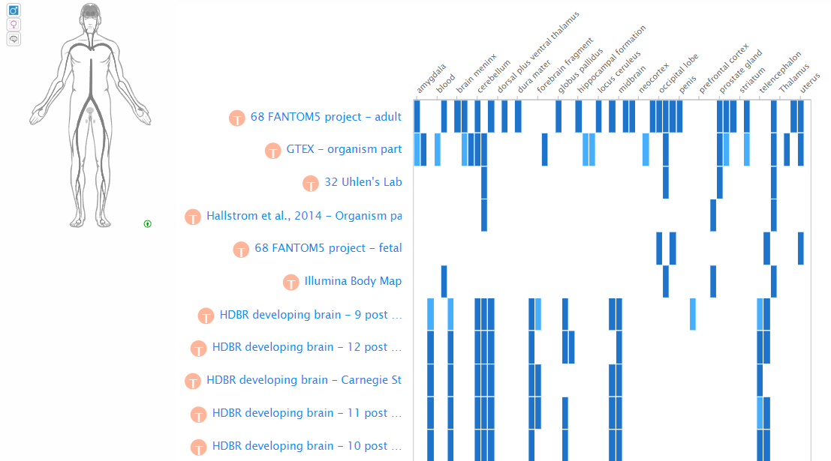
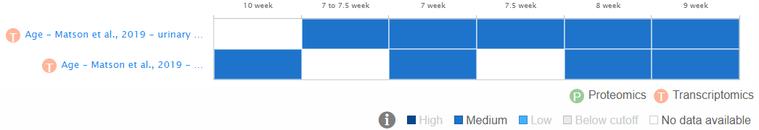
HTT gene
Analysis of HTT expression in mouse and human development has indicated that HTT is expressed from post-fertilization stages.
HTT expression levels in both mice and humans are ubiquitously distributed, with the highest levels in neurons of the CNS and testes.
The HTT gene provides instructions for making the huntingtin protein.
For full transparency and alignment with FAIR principles, a summary of our searches and results is available on our GitHub repository.
The function of the huntingtin protein is still unclear. However, it is known to possibly play roles in:
Normal brain development in gastrulation, neurulation and neurogenesis.
Brain signaling
Cell protection from apoptosis
Chemical signaling within cells
Transport of materials within cells
Binding to proteins and other structures within cells
Mitochondrial role in mitochondrial ATP synthesis and respiratory chain function
Although mutation in the HTT gene is the primary cause of HD, there are other genetic factors that may influence the onset and progression of the disease.
One of the molecular variations most strongly associated with the juvenile phenotype of HD is the FAN1 gene.
(Zuccato and Cattaneo, 2014; Ismailoglu et al. 2014)

Slide 11

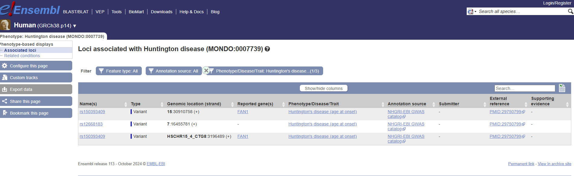
HTT gene
Analysis of HTT expression in mouse and human development has indicated that HTT is expressed from post-fertilization stages.
HTT expression levels in both mice and humans are ubiquitously distributed, with the highest levels in neurons of the CNS and testes.
Although mutation in the HTT gene is the primary cause of HD, there are other genetic factors that may influence the onset and progression of the disease.
One of the molecular variations most strongly associated with the juvenile phenotype of HD is the FAN1 gene.
(Strong et al., 1993; Landwehrmeyer et al., 1995; Sharp et al.,1995; Bhide, 1996; Sapp et al., 1997; Vonsattel & DiFiglia, 1998; Zuccato and Cattaneo, 2014)

Slide 12

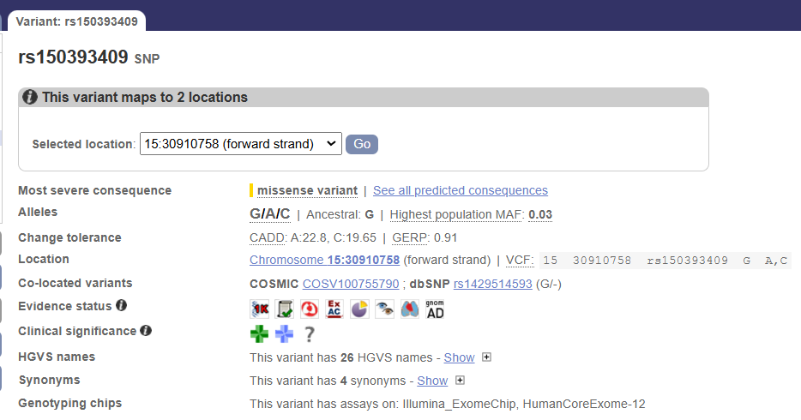
Analyzing Data
FAN1: gene associated with HD juvenile
(Deshmukh et al., 2021, Kim et al., 2020, Chao et al., 2018)

Slide 13
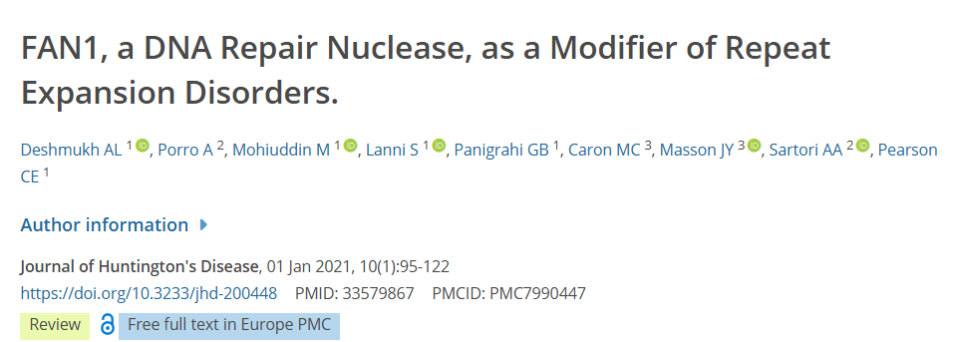
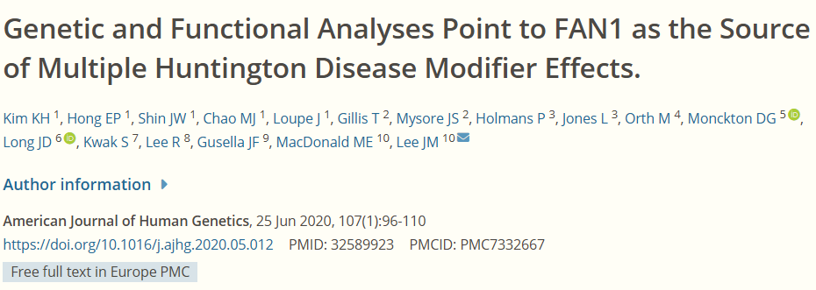
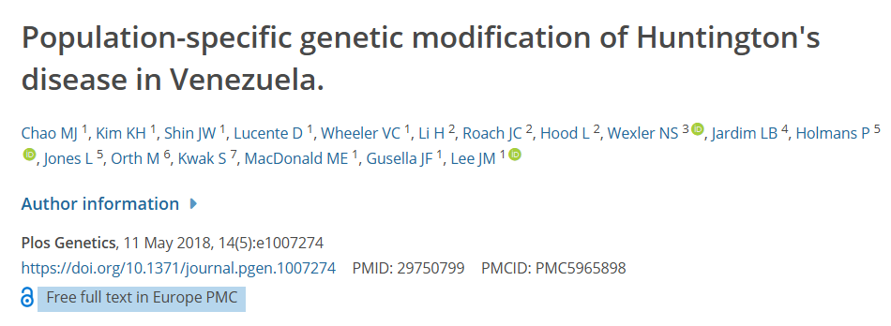
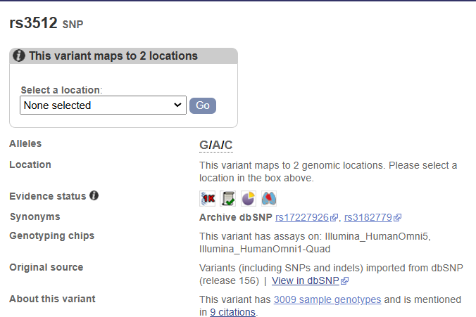
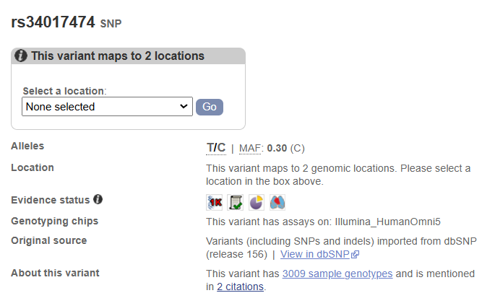
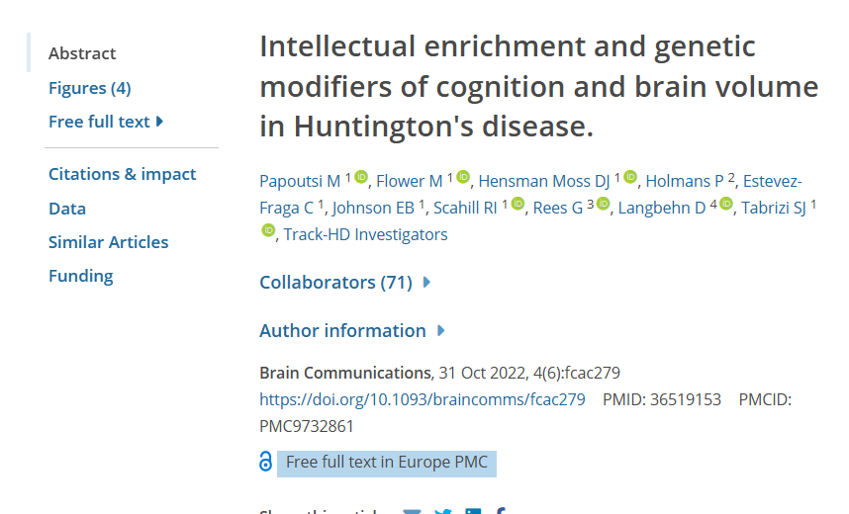
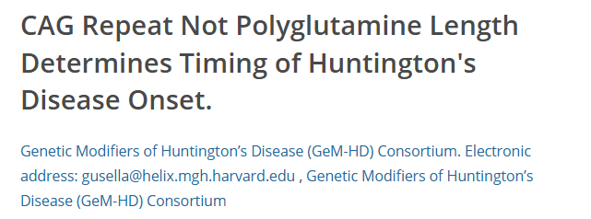
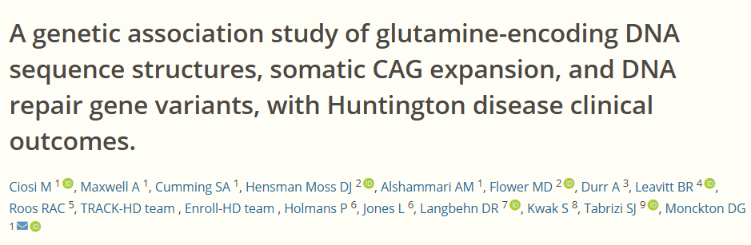
Analyzing Data
Variants in the FAN1 gene have been associated with modulation of Huntington's disease progression.
(Deshmukh et al., 2021, Kim et al., 2020, Chao et al., 2018)
(Papoutsi et al., 2022, Ciosi et al., 2019, Lee et al., 2019)

Slide 14

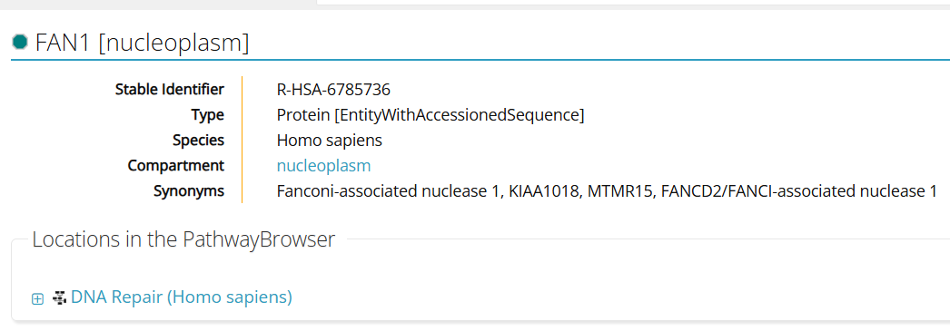
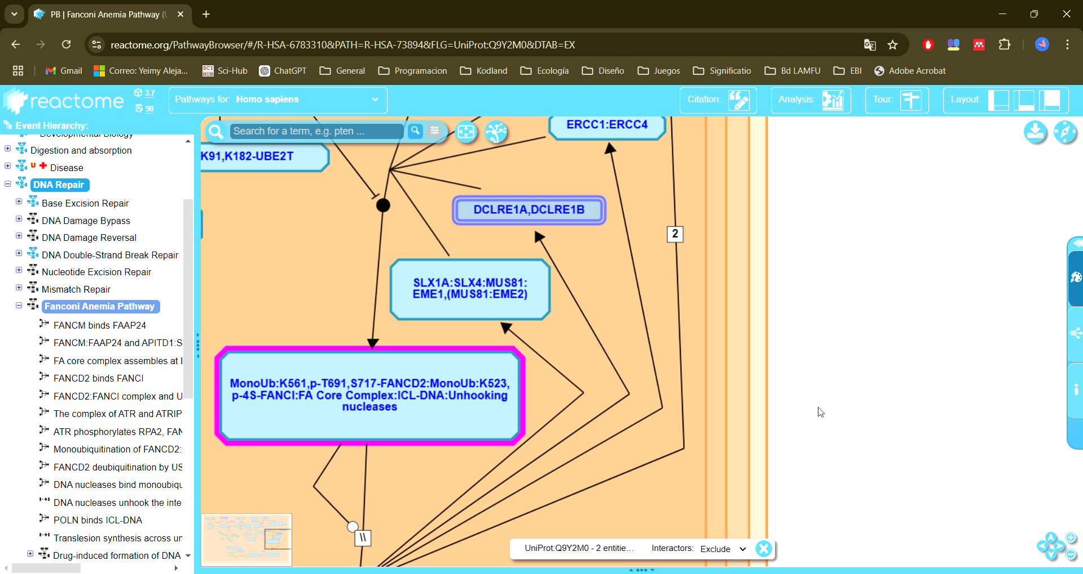
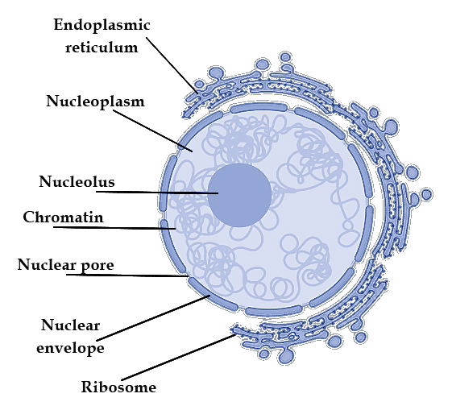
Analyzing Data
Alterations in the FAN1 gene associated with increased instability of CAG repeats and accelerated disease progression.
(Deshmukh et al., 2021, Kim et al., 2020, Chao et al., 2018)
(Papoutsi et al., 2022, Ciosi et al., 2019, Lee et al., 2019)

Slide 15

Analyzing Data
FAN1 is located in the nucleoplasm
In this site, DNA strands are processed during replication and repair
Role in maintaining genome integrity
FAN1 is involved in processes requiring access to DNA double helix, including:
Double-strand break repair
Other DNA damage repair
This specific location is essential for:
Genomic stabilization
Prevention of genetic abnormalities
FAN1 has two distinct roles in stabilizing CAG repeats:
Binds to MLH1 to limit its recruitment by MSH3, inhibiting the assembly of a functional MMR complex that would promote CAG repeat expansion.
Facilitates precise repair through its nuclease activity.
These findings highlight a potential therapeutic pathway for HD by mitigating somatic expansion
(Goold et al., 2021)
(Papoutsi et al., 2022, Ciosi et al., 2019, Lee et al., 2019)
Notes:
HTT interaction with MLH1 stabilizes CAG expansion

Slide 16
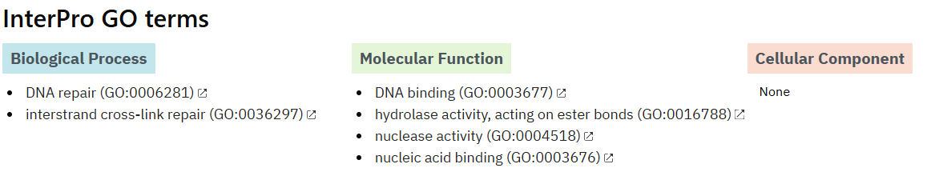
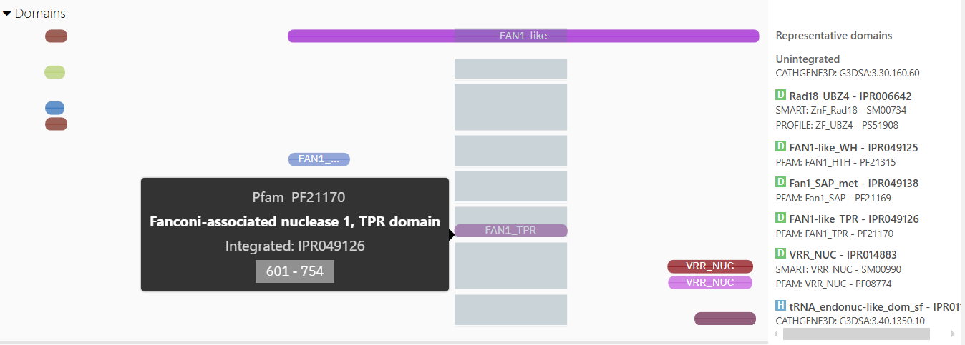


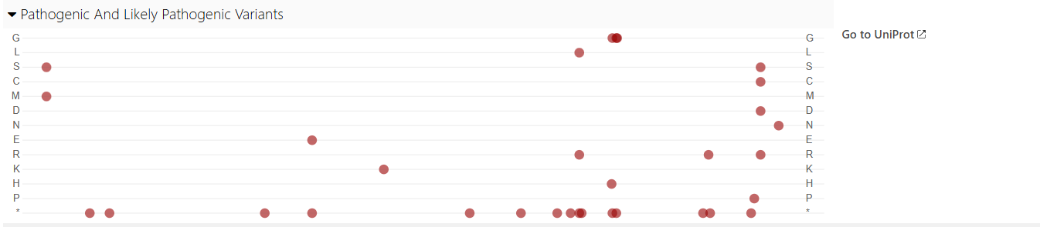
Analyzing Data
FAN1's functional classification
Biological Processes: Involved in DNA repair and interstrand cross-link repair
Molecular Functions: Has DNA binding capacity, hydrolase and nuclease activities, and nucleic acid binding capabilities
Cellular Component: No specific location listed
This confirms FAN1's primary role in DNA damage repair processes.
HD lymphobasts
HEK cells
FAN1 has two distinct roles in stabilizing CAG repeats:
Binds to MLH1 to limit its recruitment by MSH3, inhibiting the assembly of a functional MMR complex that would promote CAG repeat expansion.
Facilitates precise repair through its nuclease activity.
These findings highlight a potential therapeutic pathway for HD by mitigating somatic expansion
MutSβ
PMS2
FAN1
MLH1
MuyLα
MLH1
PMS2
CAG repeat
FAN1
PMS2
MLH1
MLH-1-PMS2 available
MLH-1-PMS2 sequestred
MRR-mediated CAG expansion
FAN1
MRR-mediated CAG expansión inhibited
PMS2
Nuclease-dependent inhibition of CAG expansion
MSH3
MLH1
MSH3
MSH2
MSH2
FAN1 strategies for CAG repeat stabilization. Adapted from Goold et al. (2021)
https://www.ebi.ac.uk/interpro/protein/UniProt/Q9Y2M0/
(Goold et al., 2021, Lee et al., 2017)
Notes:
HTT interaction with MLH1 stabilizes CAG expansion

Slide 17
Analyzing Data
FAN1's functional classification
Biological Processes: Involved in DNA repair and interstrand cross-link repair
Molecular Functions: Has DNA binding capacity, hydrolase and nuclease activities, and nucleic acid binding capabilities
Cellular Component: No specific location listed
This confirms FAN1's primary role in DNA damage repair processes.
https://www.ebi.ac.uk/interpro/protein/UniProt/Q9Y2M0/
HD lymphobasts
HEK cells
MutSβ
PMS2
FAN1
MLH1
MuyLα
MLH1
PMS2
CAG repeat
FAN1
PMS2
MLH1
MLH-1-PMS2 available
MLH-1-PMS2 sequestred
MRR-mediated CAG expansion
FAN1
MRR-mediated CAG expansión inhibited
PMS2
Nuclease-dependent inhibition of CAG expansion
MSH3
MLH1
MSH3
MSH2
MSH2
FAN1 strategies for CAG repeat stabilization. Adapted from Goold et al. (2021)

Slide 18
Analyzing Data
FAN1's key functional domains:
VRR-NUC domain (IPR014883): DNA nuclease activity
TPR (IPR049126), WH (IPR049125), SAP (IPR040603) domains: Protein-DNA interaction and binding to damaged DNA
UBZ4 zinc finger (IPR006642): Interacts with monoubiquitinated DNA regions for recruitment
https://www.ebi.ac.uk/interpro/protein/UniProt/Q9Y2M0/

Slide 19
Analyzing Data
Pathogenic/Likely Pathogenic Variants
Three mutation types are indicated:
Frameshift: Most severe - produces non-functional truncated protein
Stop gained: Severe - introduces premature stop codon
Missense: Less severe - impact depends on specific amino acid change
https://www.ebi.ac.uk/interpro/protein/UniProt/Q9Y2M0/

Slide 20

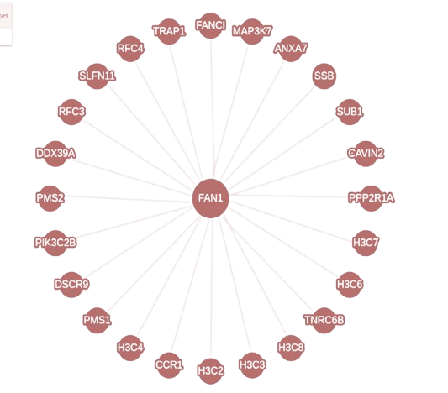
Analyzing Data
FAN1 protein interactions

Slide 21
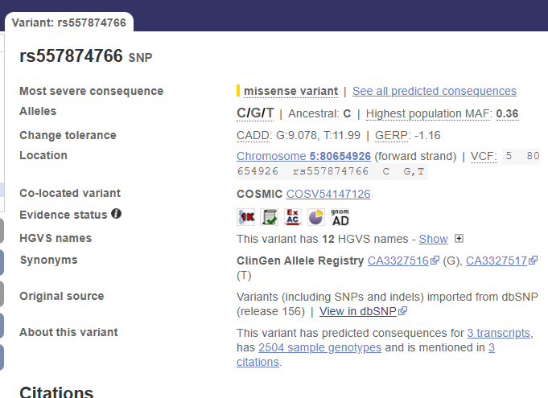
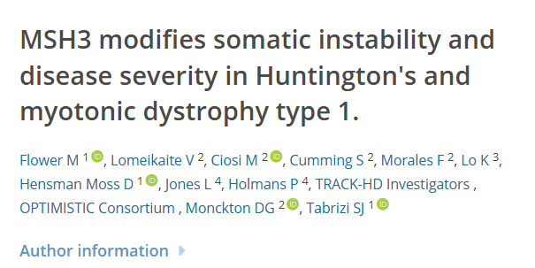
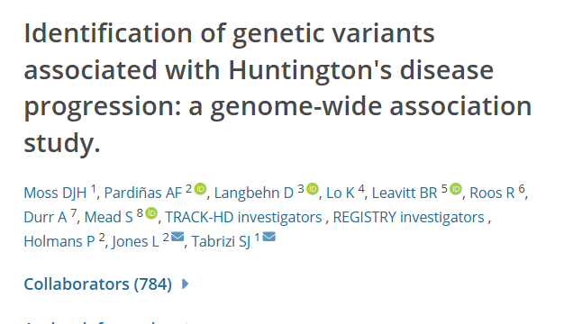
Analyzing Data
Gen MSH3 influences both age of onset and progression of the disease
(Moss et al., 2017, Flower et al., 2019)

Slide 22
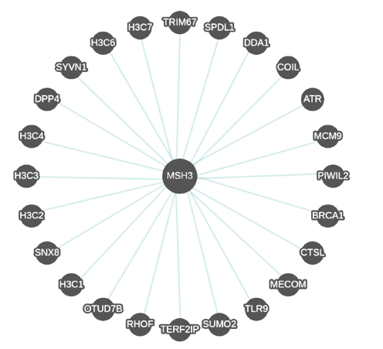
Analyzing Data
Gen MSH3 influences both age of onset and progression of the disease

Slide 23

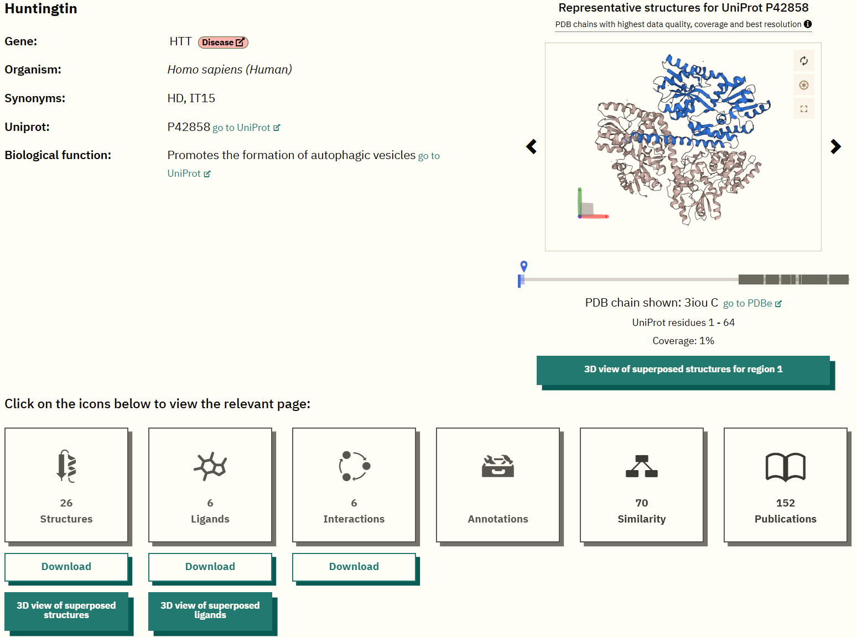
Analyzing Data
HTT association with HAP40
HAP40 (Huntingtin-Associated Protein 40, shown in gray) appears in multiple HTT structural models.
HAP40 plays a key role in HTT structural stabilization.

Slide 24


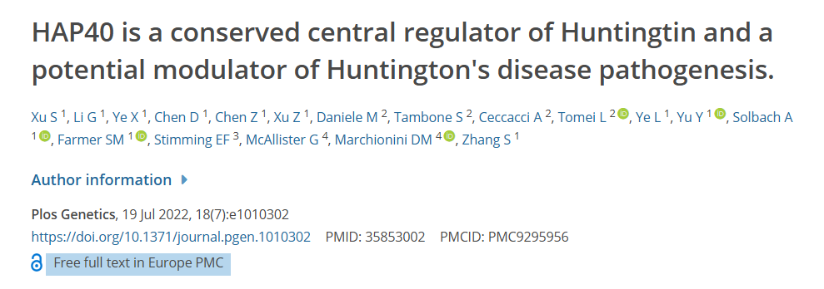
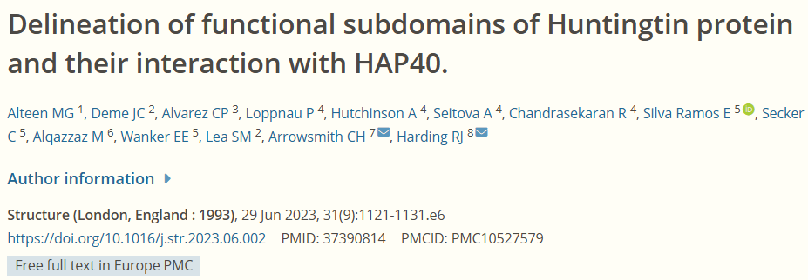
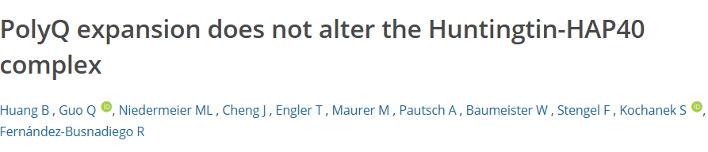
Analyzing Data
HAP40 protein overexpression decreases mutant HTT aggregates and improves neuronal and behavioral function
MECP2 and its relationship to Huntington's disease.
Although MECP2 is most associated with Rett syndrome, its role in epigenetic regulation may influence the progression of juvenile Huntington's disease.
This gene encodes a protein that interacts with methylated regions of DNA, affecting the expression of key genes involved in neuronal processes.
Although MECP2 is most associated with Rett syndrome, its role in epigenetic regulation may influence the progression of juvenile Huntington's disease.
This gene encodes a protein that interacts with methylated regions of DNA, affecting the expression of key genes involved in neuronal processes.
(Xu et al., 2022, Alteen et al., 2023, Huang et al., 2021)

Slide 25
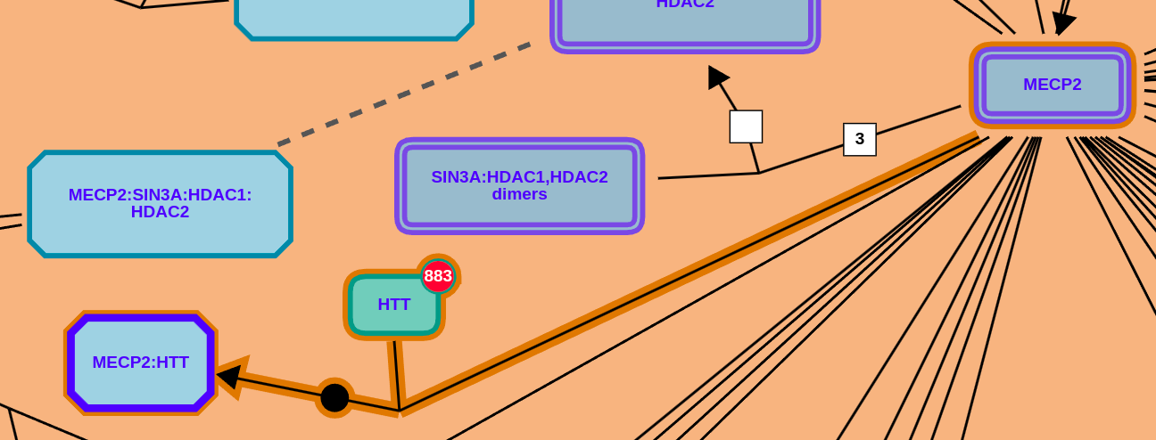
Analyzing Data
MECP2 and its relationship to Huntington's disease.
Although MECP2 is most associated with Rett syndrome, its role in epigenetic regulation may influence the progression of juvenile Huntington's disease.
This gene encodes a protein that interacts with methylated regions of DNA, affecting the expression of key genes involved in neuronal processes.
(Liyanage et al. 2013)
Data analysis included the identification of protein-protein interaction networks, highlighting functional links that may influence the stability of CAG repeats in the HTT gene.

Slide 26
Graphene oxide and autophagy in Huntington’s disease
Analyzing Data
Data analysis included the identification of protein-protein interaction networks, highlighting functional links that may influence the stability of CAG repeats in the HTT gene.
Graphene oxide (GO) offers an innovative approach by regulating autophagy and stabilizing critical pathways.
Properties of Graphene Oxide
Chemical:
Oxygenated functional groups (hydroxyl, carboxyl, and epoxide).
Ability to interact with specific biological molecules.
Physical:
Two-dimensional structure, like an ultrathin sheet.
High affinity for damaged proteins such as HTTm.

Slide 27
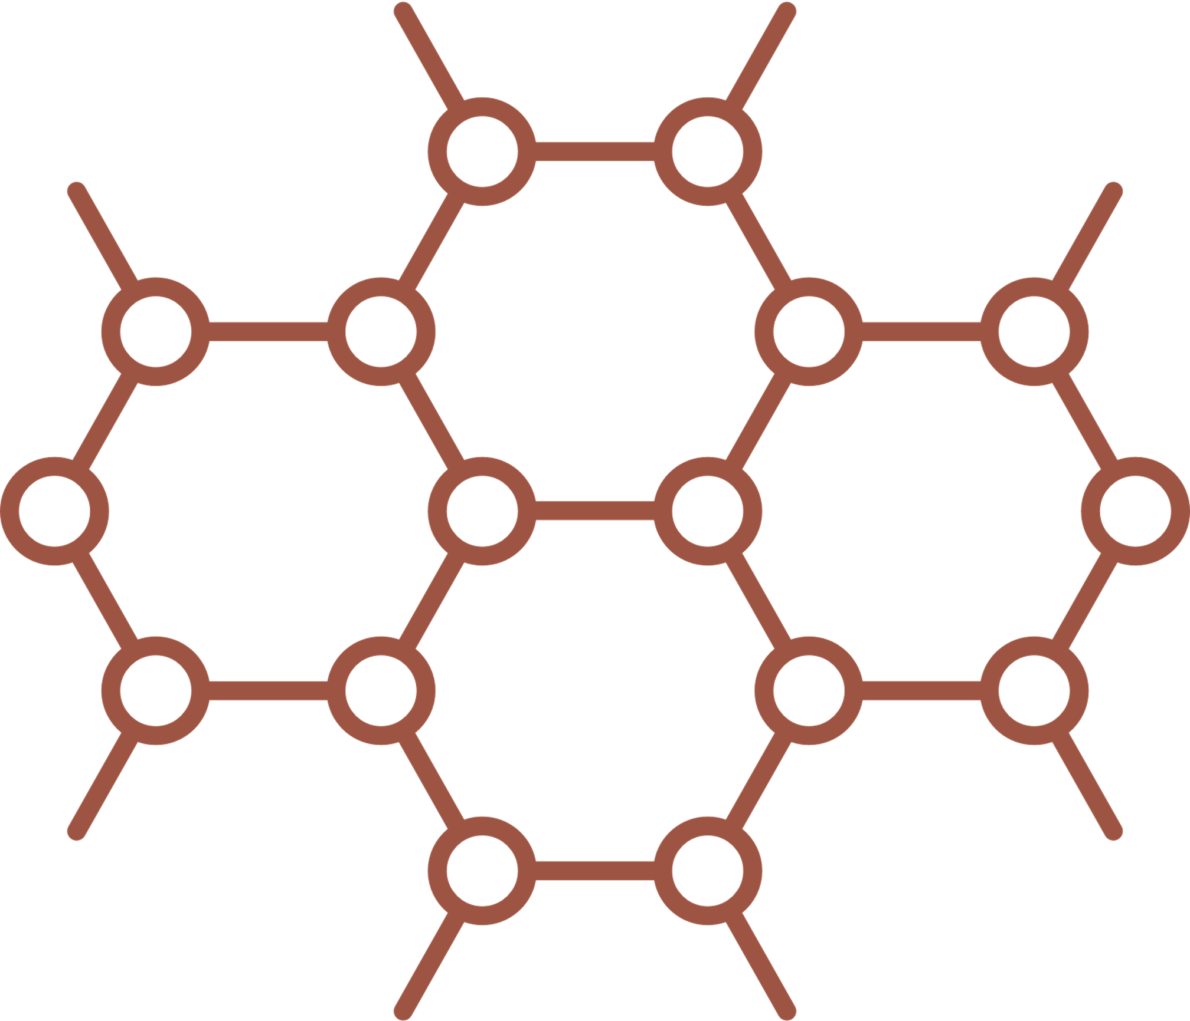





Graphene oxide and autophagy in Huntington’s disease
Graphene oxide (GO) offers an innovative approach by regulating autophagy and stabilizing critical pathways.
Properties of Graphene Oxide
Chemical:
Oxygenated functional groups (hydroxyl, carboxyl, and epoxide).
Ability to interact with specific biological molecules.
Physical:
Two-dimensional structure, like an ultrathin sheet.
High affinity for damaged proteins such as HTTm.
(Jin et al.2016)
Graphene oxide acts as a 'garbage truck,' transporting waste to autophagosomes.
It removes toxic aggregates like HTTm by tagging them with ubiquitin for degradation.
Graphene oxide regulates autophagy, the 'recycling system' of cells.

Slide 28

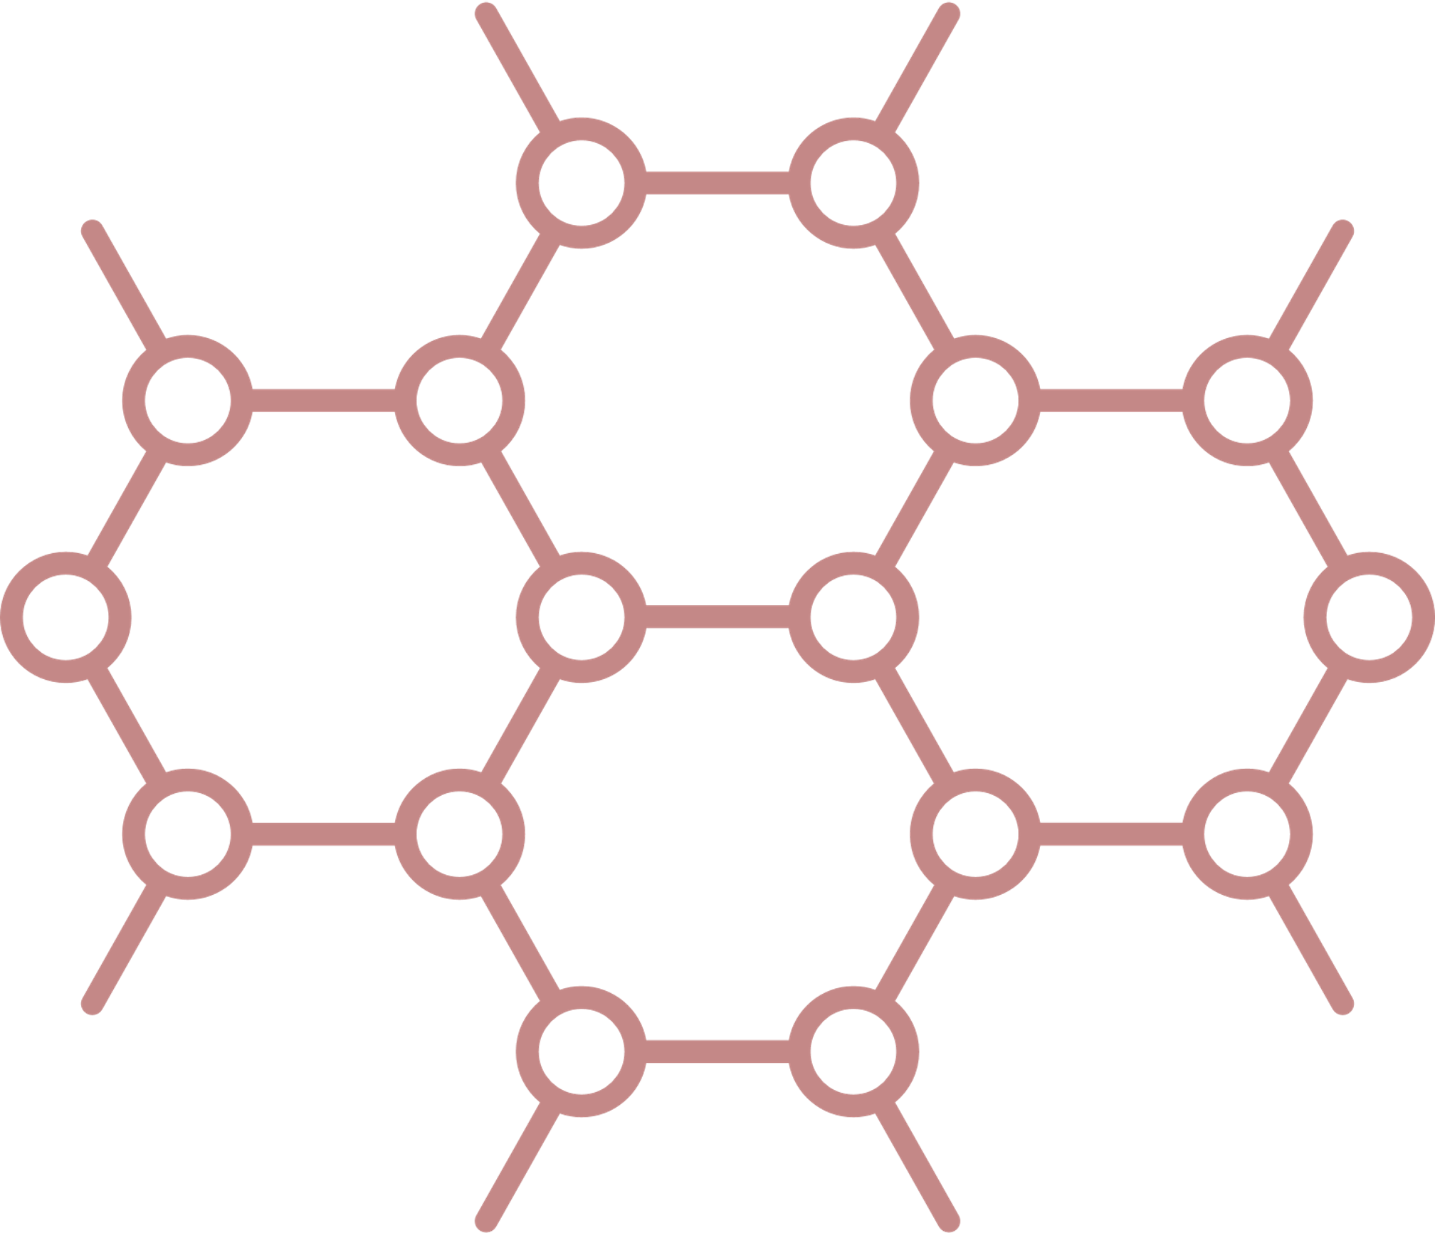
Graphene oxide and its role in autophagy
Advantages of graphene oxide over mTOR
Graphene oxide activates autophagy without inhibiting mTOR, avoiding severe side effects
Graphene oxide (GO) offers an innovative approach by regulating autophagy and stabilizing critical pathways.
Graphene oxide regulates autophagy, the 'recycling system' of cells.
It removes toxic aggregates like HTTm by tagging them with ubiquitin for degradation.
Graphene oxide acts as a 'garbage truck,' transporting waste to autophagosomes.
Properties of Graphene Oxide
Chemical:
Oxygenated functional groups (hydroxyl, carboxyl, and epoxide).
Ability to interact with specific biological molecules.
Physical:
Two-dimensional structure, like an ultrathin sheet.
High affinity for damaged proteins such as HTTm.
Graphene oxide is safer as it activates autophagy without disrupting mTOR, avoiding adverse effects on growth, metabolism, and protein synthesis.
(Jin et al.2016)

Slide 29
Advantages of graphene oxide over mTOR
Graphene oxide activates autophagy without inhibiting mTOR, avoiding severe side effects
Graphene oxide is safer as it activates autophagy without disrupting mTOR, avoiding adverse effects on growth, metabolism, and protein synthesis.
(Jin et al.2016)

Slide 30
Conclusions
Treating Huntington’s disease is like cleaning a city full of toxic waste
Graphene oxide acts as an advanced recycling system, removing toxic aggregates like HTTm.
FAN1: Repairs DNA, stabilizes CAG repeats, and reduces somatic expansion
HAP40: Enhances HTTm stability and prevents new aggregates.
Graphene oxide, FAN1, and HAP40 mitigate critical pathways like MECP2, linked to worsening symptoms.
These multifocal strategies address visible symptoms and underlying causes.
By combining toxic protein removal and genetic repair, this approach offers tangible hope for patients and their families.

Slide 31
References
Andrich, J., Arning, L., Wieczorek, S., Kraus, P. H., Gold, R., & Saft, C. (2008). Huntington's disease as caused by 34 CAG repeats. Movement Disorders, 23(6), 879-881.
Alteen, M. G., Deme, J. C., Alvarez, C. P., Loppnau, P., Hutchinson, A., Seitova, A., ... & Harding, R. J. (2023). Delineation of functional subdomains of Huntingtin protein and their interaction with HAP40. Structure, 31(9), 1121-1131.
Bates, G. P., Dorsey, R., Gusella, J. F., Hayden, M. R., Kay, C., Leavitt, B. R., … Tabrizi, S. J. (2015). Huntington disease. Nature Reviews Disease Primers, 15005. doi:10.1038/nrdp.2015.5
Bhide, P. G., Day, M., Sapp, E., Schwarz, C., Sheth, A., Kim, J., ... & DiFiglia, M. (1996). Expression of normal and mutant huntingtin in the developing brain. Journal of Neuroscience, 16(17), 5523-5535.
Chao, M. J., Kim, K. H., Shin, J. W., Lucente, D., Wheeler, V. C., Li, H., ... & Lee, J. M. (2018). Population-specific genetic modification of Huntington's disease in Venezuela. PLoS genetics, 14(5), e1007274.
Ciosi, M., Maxwell, A., Cumming, S. A., Moss, D. J. H., Alshammari, A. M., Flower, M. D., ... & Monckton, D. G. (2019). A genetic association study of glutamine-encoding DNA sequence structures, somatic CAG expansion, and DNA repair gene variants, with Huntington disease clinical outcomes. EBioMedicine, 48, 568-580.
Deshmukh, A. L., Porro, A., Mohiuddin, M., Lanni, S., Panigrahi, G. B., Caron, M. C., ... & Pearson, C. E. (2021). FAN1, a DNA repair nuclease, as a modifier of repeat expansion disorders. Journal of Huntington's disease, 10(1), 95-122.
Du, G., Dong, W., Yang, Q., Yu, X., Ma, J., Gu, W., & Huang, Y. (2021). Altered gut microbiota related to inflammatory responses in patients with Huntington’s disease. Frontiers in Immunology, 11, 603594.
Flower, M., Lomeikaite, V., Ciosi, M., Cumming, S., Morales, F., Lo, K., ... & Tabrizi, S. J. (2019). MSH3 modifies somatic instability and disease severity in Huntington’s and myotonic dystrophy type 1. Brain, 142(7), 1876-1886.
Goold, R., Hamilton, J., Menneteau, T., Flower, M., Bunting, E. L., Aldous, S. G., Porro, A., Vicente, J. R., Allen, N. D., Wilkinson, H., Bates, G. P., Sartori, A. A., Thalassinos, K., Balmus, G., & Tabrizi, S. J. (2021). FAN1 controls mismatch repair complex assembly via MLH1 retention to stabilize CAG repeat expansion in Huntington’s disease. Cell Reports, 36(9).

Slide 32
References
Ha, A. D., Beck, C. A., & Jankovic, J. (2012). Intermediate CAG repeats in Huntington's disease: analysis of COHORT. Tremor and other hyperkinetic movements, 2.
Kim, K. H., Hong, E. P., Shin, J. W., Chao, M. J., Loupe, J., Gillis, T., ... & Lee, J. M. (2020). Genetic and functional analyses point to FAN1 as the source of multiple Huntington disease modifier effects. The American Journal of Human Genetics, 107(1), 96-110.
Ismailoglu, I., Chen, Q., Popowski, M., Yang, L., Gross, S. S., & Brivanlou, A. H. (2014). Huntingtin protein is essential for mitochondrial metabolism, bioenergetics and structure in murine embryonic stem cells. Developmental biology, 391(2), 230-240.
Jin, P., Wei, P., Zhang, Y., Lin, J., Sha, R., Hu, Y., Zhang, J., Zhou, W., Yao, H., Ren, L., Yang, J. Y., Liu, Y., & Wen, L. (2016). Autophagy-mediated clearance of ubiquitinated mutant huntingtin by graphene oxide. Nanoscale.
Langbehn, D. R., Hayden, M. R., Paulsen, J. S., Johnson, H., Aylward, E., Biglan, K., Kieburtz, K., Oakes, D., Shoulson, I., Guttman, M., Landwehrmeyer, B. G., Nance, M., Ross, C., & Stout, J. (2010). CAG-repeat length and the age of onset in Huntington Disease (HD): A review and validation study of statistical approaches. In American Journal of Medical Genetics, Part B: Neuropsychiatric Genetics (Vol. 153, Issue 2, pp. 397–408)
Landwehrmeyer, G. B., McNeil, S. M., Dure IV, L. S., Ge, P., Aizawa, H., Huang, Q., ... & Vonsattel, J. P. (1995). Huntington's disease gene: regional and cellular expression in brain of normal and affected individuals. Annals of Neurology: Official Journal of the American Neurological Association and the Child Neurology Society, 37(2), 218-230.
Lee, J. M., Correia, K., Loupe, J., Kim, K. H., Barker, D., Hong, E. P., ... & Myers, R. H. (2019). CAG repeat not polyglutamine length determines timing of Huntington’s disease onset. Cell, 178(4), 887-900.
Liyanage, V. R., et al. (2013). DNA methylation in the regulation of MeCP2 and its role in Rett syndrome. Epigenomics, 5(2), 185-194. https://doi.org/10.2217/epi.13.13
Moss, D. J. H., Pardiñas, A. F., Langbehn, D., Lo, K., Leavitt, B. R., Roos, R., ... & Hecht, K. (2017). Identification of genetic variants associated with Huntington's disease progression: a genome-wide association study. The Lancet Neurology, 16(9), 701-711.
Papoutsi, M., Flower, M., Hensman Moss, D. J., Holmans, P., Estevez-Fraga, C., Johnson, E. B., ... & Tabrizi, S. J. (2022). Intellectual enrichment and genetic modifiers of cognition and brain volume in Huntington’s disease. Brain Communications, 4(6), fcac279.

Slide 33
References
Rubinsztein, D. C., Leggo, J., Coles, R., Almqvist, E., Biancalana, V., Cassiman, J. J., ... & Hayden, M. R. (1996). Phenotypic characterization of individuals with 30–40 CAG repeats in the Huntington disease (HD) gene reveals HD cases with 36 repeats and apparently normal elderly individuals with 36–39 repeats. American journal of human genetics, 59(1), 16.
Sapp, E., Schwarz, C., Chase, K., Bhide, P. G., Young, A. B., Penney, J., ... & DiFiglia, M. (1997). Huntingtin localization in brains of normal and Huntington's disease patients. Annals of Neurology: Official Journal of the American Neurological Association and the Child Neurology Society, 42(4), 604-612
Sharp, A. H., Loev, S. J., Schilling, G., Li, S. H., Li, X. J., Bao, J., ... & Ross, C. A. (1995). Widespread expression of Huntington's disease gene (IT15) protein product. Neuron, 14(5), 1065-1074.
Strong, T. V., Tagle, D. A., Valdes, J. M., Elmer, L. W., Boehm, K., Swaroop, M., ... & Albin, R. L. (1993). Widespread expression of the human and rat Huntington's disease gene in brain and nonneural tissues. Nature genetics, 5(3), 259-265.
Vonsattel, J. P. G., & DiFiglia, M. (1998). Huntington disease. Journal of neuropathology and experimental neurology, 57(5), 369.
Xu, S., Li, G., Ye, X., Chen, D., Chen, Z., Xu, Z., ... & Zhang, S. (2022). HAP40 is a conserved central regulator of Huntingtin and a potential modulator of Huntington’s disease pathogenesis. PLoS Genetics, 18(7), e1010302.
Young, A. B. (2003). Huntingtin in health and disease. The Journal of clinical investigation, 111(3), 299-302.
Zuccato, C., & Cattaneo, E. (2014). Normal function of huntingtin. In Huntington's disease (pp. 243-273). Oxford University Press.

Slide 34


Thank you

Slide 35





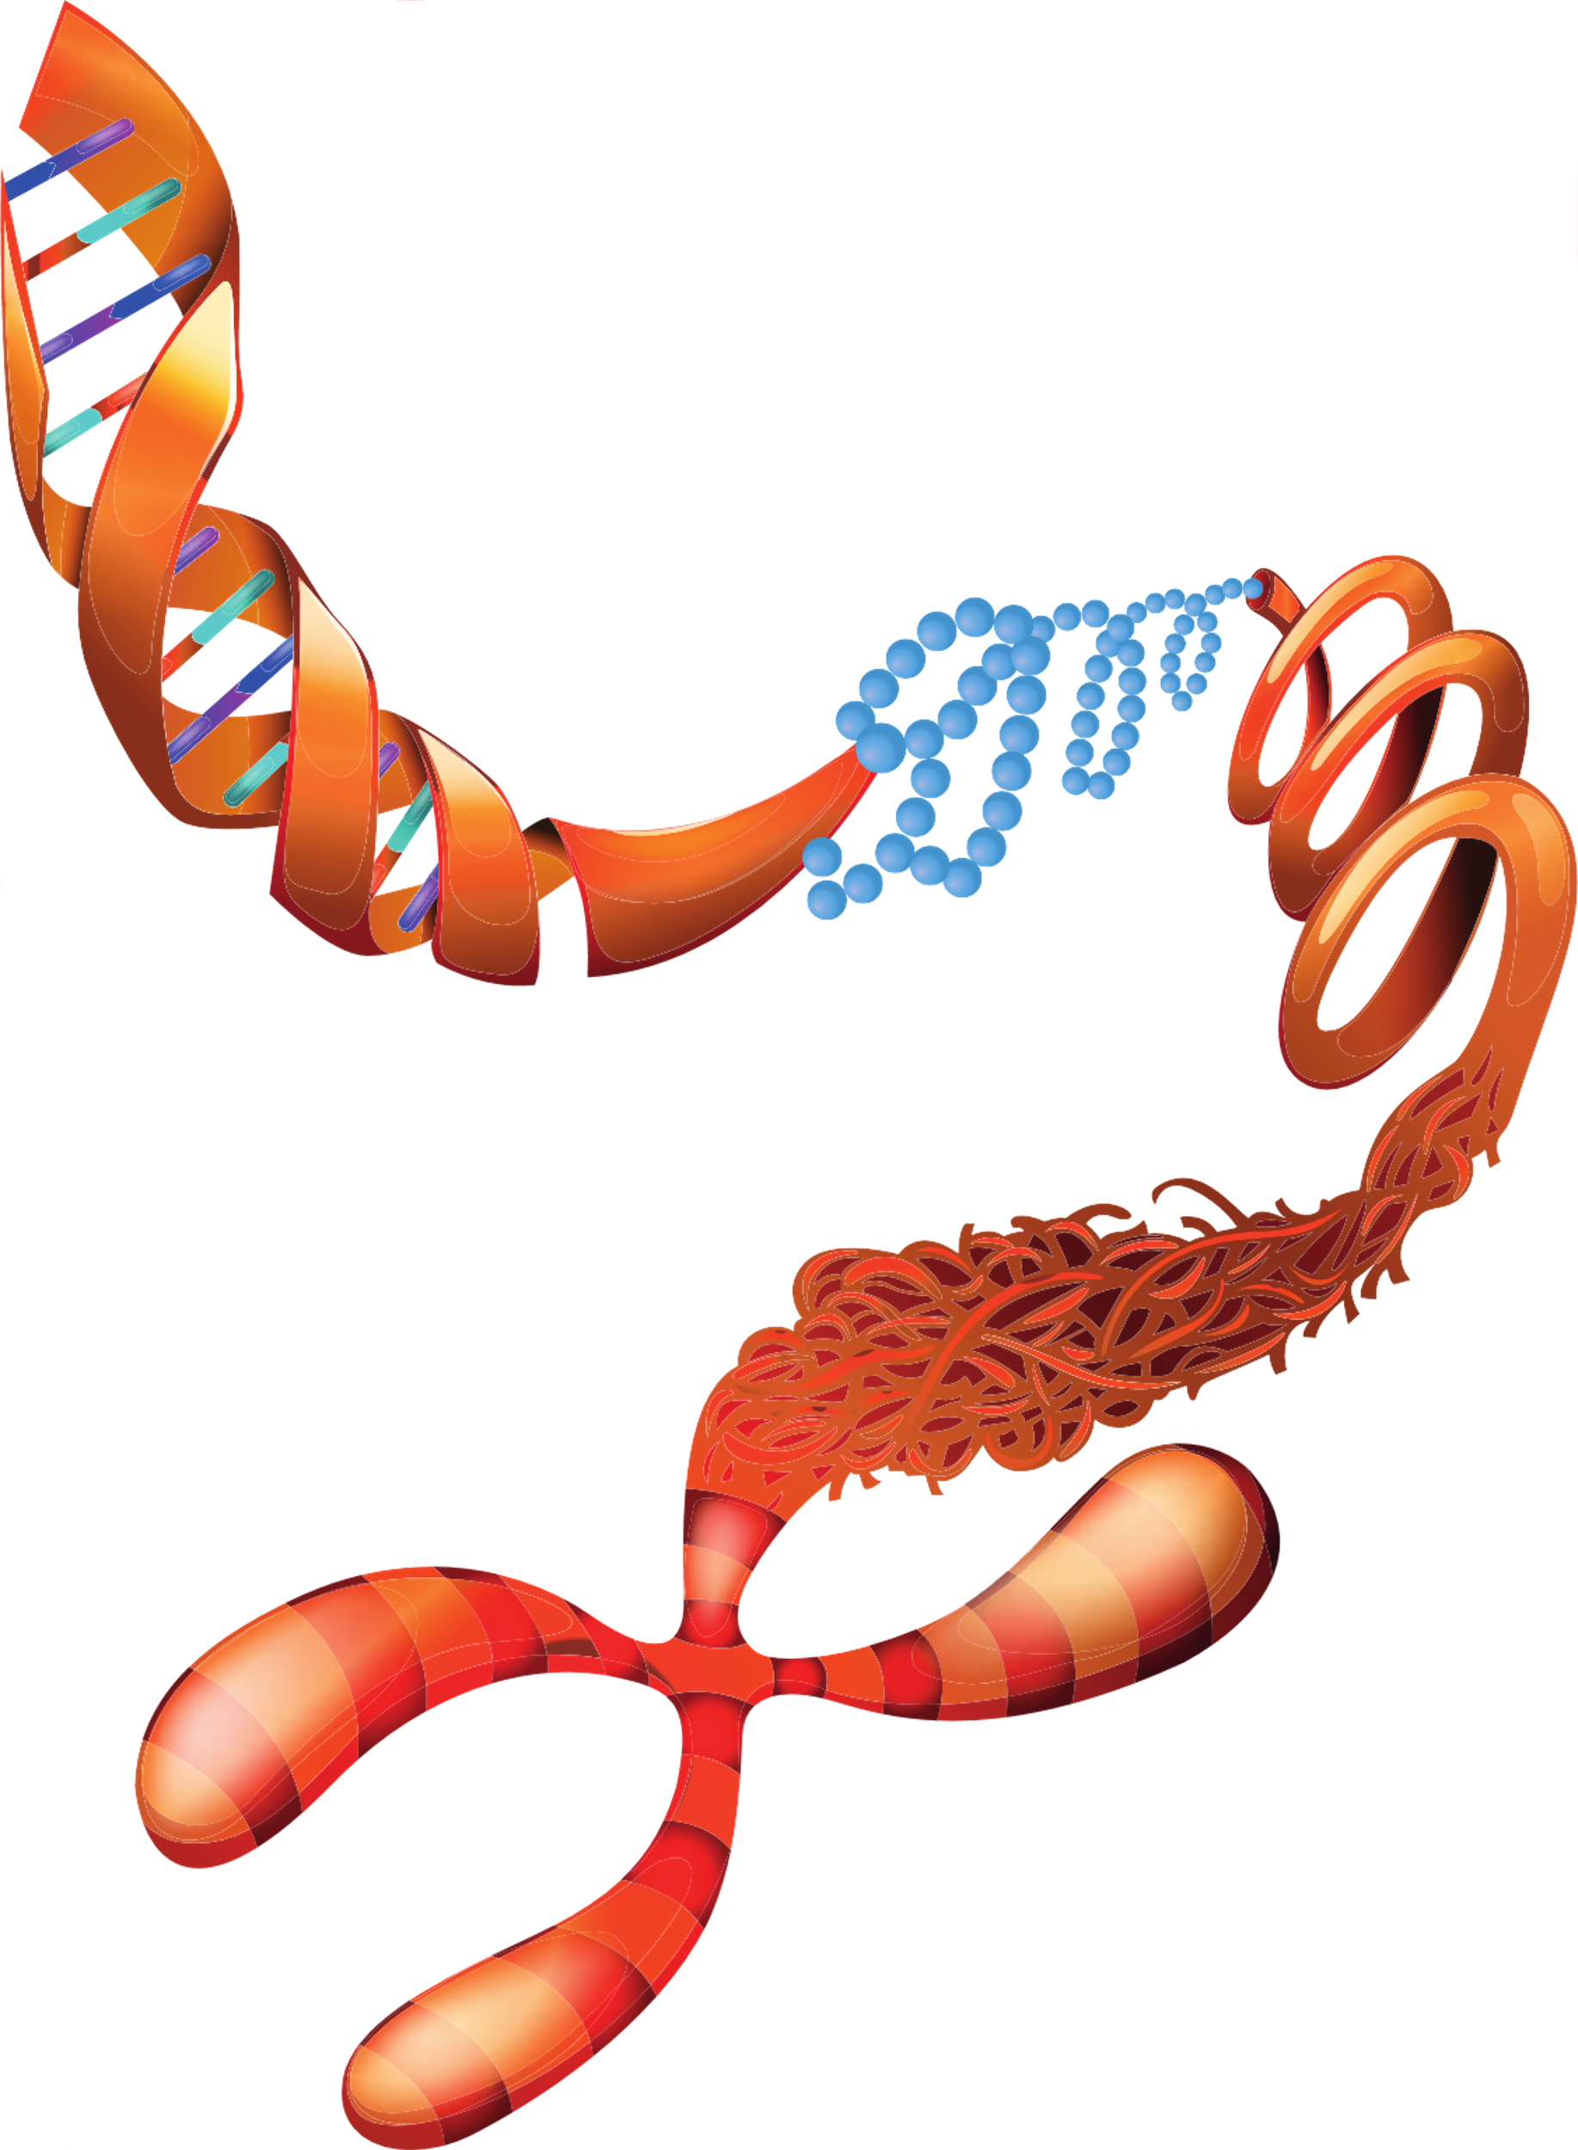



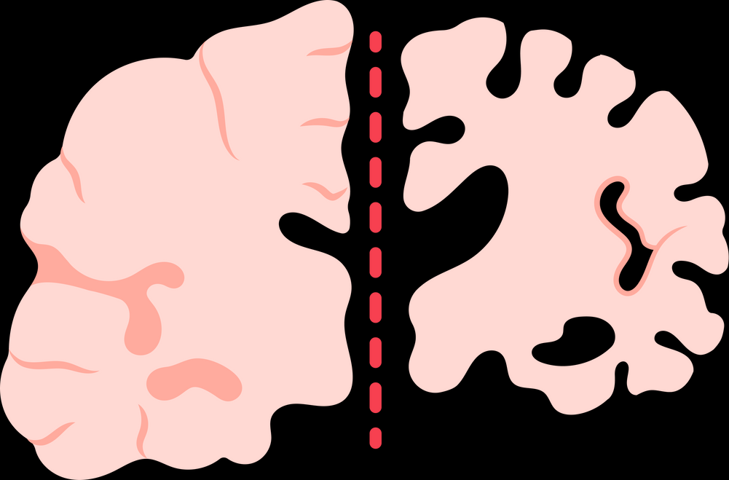

Slide 36









